Slide 1
1. Multi - Threading
2. Intent filter
3. Broadcast Receiver
4. Android Services
5. Webservice .Net

Slide 2
1. Multi - Threading
1.1 Introduction
1.2 Handler class
1.3 AsyncTask class

Slide 3
1.1 Introduction
Threads
Android’s threads run in a manner similar to common Java threads
A Thread is a concurrent unit of execution.
not executing in order
has its own call stack for methods being invoked, their arguments and local variables.
Each virtual machine instance has at least one main Thread running when it is started;
The application might decide to launch additional Threads for specific purposes.

Slide 4
1.1 Introduction
Multi- Threading

Slide 5
1.1 Introduction
Multi- Threading
Threads in the same VM interact and synchronize by the use of shared objects and monitors associated with these objects.
There are basically two main ways of having a Thread execute application code.
1.Create a new class that extends Thread and override its run() method.
2.Create a new Thread instance passing to it a Runnable object.
In both cases, the start() method must be called to actually execute the new Thread.

Slide 6
1.1 Introduction
Advantages of Multi- Threading
Threads share the process' resources but are able to execute independently.
Applications responsibilities can be separated main thread runs UI, and slow tasks are sent to background threads.
Threading provides an useful abstraction of concurrent execution.
Particularly useful in the case of a single process that spawns multiple threads on top of a multiprocessor system. In this case real parallelism is achieved.
Consequently, a multithreaded program operates faster on computer systems that have multiple CPUs.

Slide 7
1.1 Introduction
Disadvantages of Multi- Threading
Code :more complex
Need to detect, avoid, resolve deadlocks
Threads not executing in order
Runnable v.s Thread?
What different?
Deadlock and Atomic type

Slide 8
1.2 Handler class
An application may involve a time-consuming operation, however we want the UI to be responsive to the user. Android offers two ways for dealing with this scenario:
Do expensive operations in a background service, using notifications to inform users about next step
Do the slow work in a background thread. Interaction between Android threads is accomplished using (a) Handler objects and (b) posting Runnable objects to the main view.

Slide 9
1.2 Handler class
When a process is created for your application, its main thread is dedicated to running a message queue that takes care of managing the top-level application objects (activities, intent receivers, etc) and any windows they create.
You can create your own secondary threads, and communicate back with the main application thread through a Handler.
When you create a new Handler, it is bound to the message queue of the thread that is creating it -- from that point on, it will deliver messages and runnables to that message queue and execute them as they come out of the message queue.

Slide 10
1.2 Handler class
There are two main uses for a Handler:
(1)to schedule messages and runnables to be executed as some point in the future; and
(2)to enqueue an action to be performed on another thread

Slide 11
1.2 Handler class
Threads and UI Warning
Background threads are not allowed to interact with the UI.
Only the main process can access the (main) activity’s view.
(Global) class variables can be seen and updated in the threads

Slide 12
1.2 Handler class
Handler’s MessageQueue
A secondary thread that wants to communicate with the main thread must request a message token using the obtainMessage() method.
Once obtained, the background thread can fill data into the message token and attach it to the Handler‟s message queue using the sendMessage() method.
The Handler uses the handleMessage() method to continuously attend new messages arriving to the main thread.
A message extracted from the process’ queue can either return some data to the main process or request the execution of runnable objects through the post() method.

Slide 13
1.2 Handler class
Handler’s MessageQueue

Slide 14
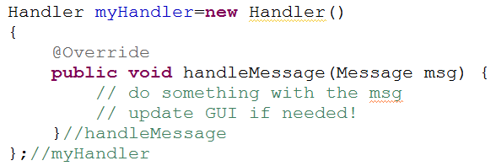
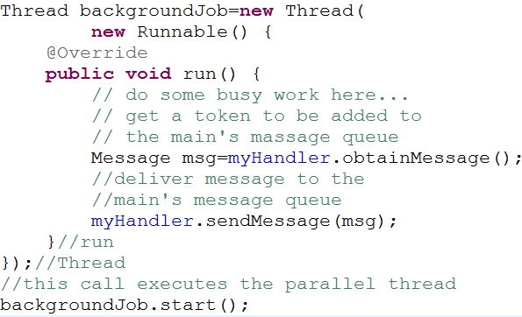
1.2 Handler class
Using Messages
Main Thread | Background Thread
… … | … …

Slide 15
1.2 Handler class

Slide 16
1.2 Handler class
Messages
To send a Message to a Handler, the thread must first invoke obtainMessage() to get the Message object out of the pool.
There are a few forms of obtainMessage(), allowing you to just create an empty Message object, or messages holding arguments
Example
// thread 1 produces some local data
String localData = “Greeting from thread 1”;
// thread 1 requests a message & adds localData to it
Message mgs = myHandler.obtainMessage (1, localData);

Slide 17
1.2 Handler class
sendMessage Method
You deliver the message using one of the sendMessage...() family of methods, such as …
•sendMessage() puts the message at the end of the queue immediately
• sendMessageAtFrontOfQueue() puts the message at the front of the queue immediately (versus the back, as is the default), so your message takes priority over all others
• sendMessageAtTime() puts the message on the queue at the stated time, expressed in the form of milliseconds based on system uptime (SystemClock.uptimeMillis())
• sendMessageDelayed() puts the message on the queue after a delay, expressed in milliseconds

Slide 18
1.2 Handler class
Processing Messages
To process messages sent by the background threads, your Handler needs to implement the listener
handleMessage( . . . )
which will be called with each message that appears on the message queue.
There, the handler can update the UI as needed. However, it should still do that work quickly, as other UI work is suspended until the Handler is done.

Slide 19
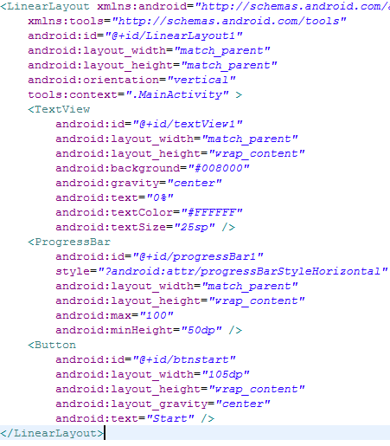
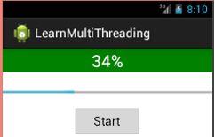
1.2 Handler class
XML Layout
Examples
– Using Message

Slide 20
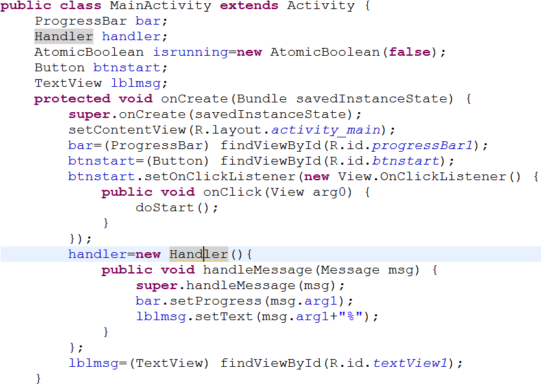
1.2 Handler class
Coding
msg get from sendMessage in background thread

Slide 21
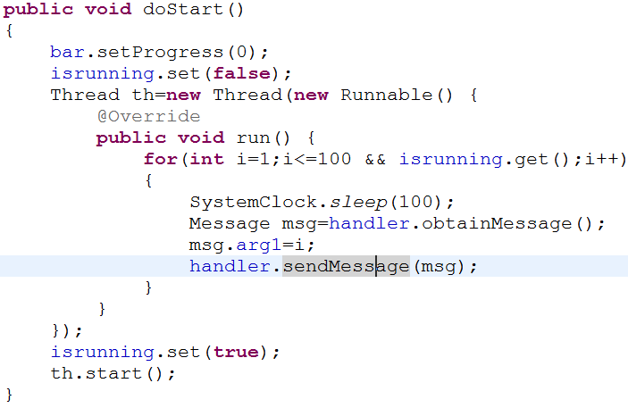
1.2 Handler class
Coding
msg get from main Thread
msg send to main Thread, process in handleMessage
We could use msg.arg1, msg.arg2, msg.obj (store Object) , msg.what to process message

Slide 22
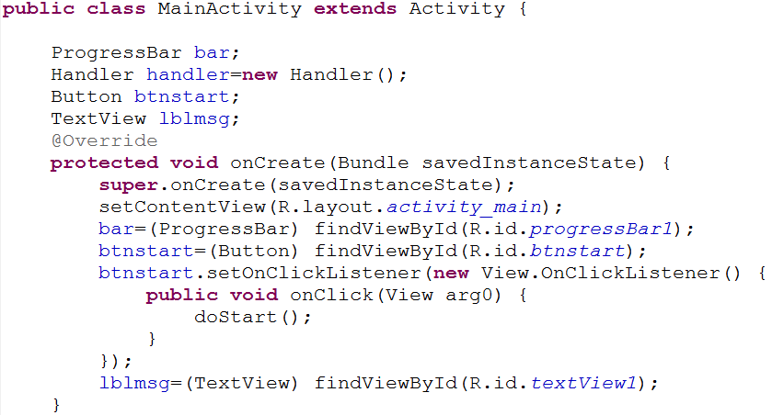
1.2 Handler class
Examples – using post

Slide 23
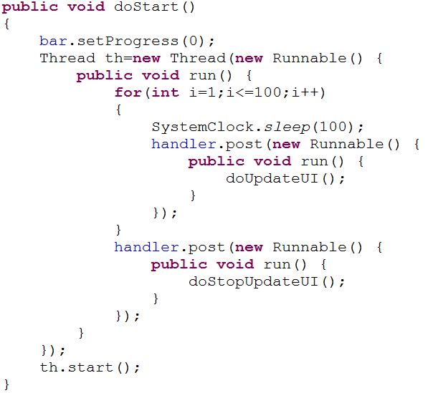
1.2 Handler class

Slide 24
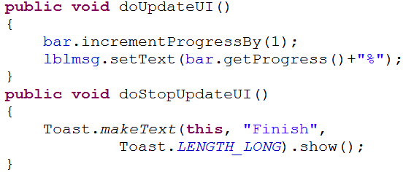
1.2 Handler class

Slide 25
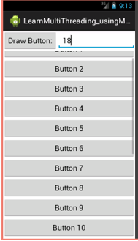
1.2 Handler class
Exercise: Draw Button at runtime on the View as below
Whe click on the “Draw Button:”:
- After 1 second, application will draw 1 button. The number of button is entered in the EditText.
- Must use MultiThreading (Message or post)

Slide 26
1.3 AsyncTask class

Slide 27
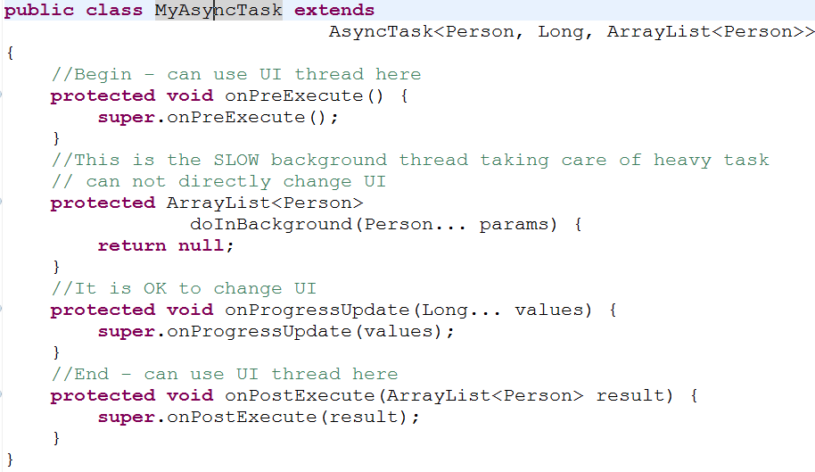
1.3 AsyncTask class

Slide 28
1.3 AsyncTask class
Start by execute method
AsyncTask enables proper and easy use of the UI thread.
This class allows to perform background operations and publish results on the UI thread without having to manipulate threads and/or handlers.
An asynchronous task is defined by a computation that runs on a background thread and whose result is published on the UI thread.
An asynchronous task is defined by

Slide 29
1.3 AsyncTask class
AsyncTask <Params, Progress, Result>
Not all types are always used by an asynchronous task. To mark a type as unused, simply use the type Void
Note: Syntax “String ...” indicates (Varargs) array of String values, similar to “String[]”

Slide 30
1.3 AsyncTask class
AsyncTask's methods
onPreExecute(), invoked on the UI thread immediately after the task is executed. This step is normally used to setup the task, for instance by showing a progress bar in the user interface.
doInBackground(Params...), invoked on the background thread after onPreExecute() finishes executing: perform long time background computation. The parameters of the asynchronous task are passed to this step. The result of the computation must be returned by this step and will be passed back to the last step. This step can also use publishProgress(Progress...) to publish one or more units of progress. These values are published on the UI thread, in the onProgressUpdate(Progress...) step.
onProgressUpdate(Progress...), invoked on the UI thread after a call to publishProgress(Progress...). The timing of the execution is undefined. This method is used to display any form of progress in the user interface while the background computation is still executing. For instance, it can be used to animate a progress bar or show logs in a text field.
onPostExecute(Result), invoked on the UI thread after the background computation finishes. The result of the background computation is passed to this step as a parameter.

Slide 31
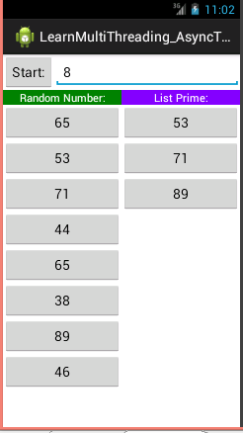
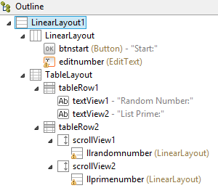
1.3 AsyncTask class
Examples : combine AsyncTask and Handler class

Slide 32
1.3 AsyncTask class
Examples : combine AsyncTask and Handler class
Random Number: Auto draw button with random number in the left side
List prime: Auto draw list Prime butto when the Random number is finished in the Right side

Slide 33
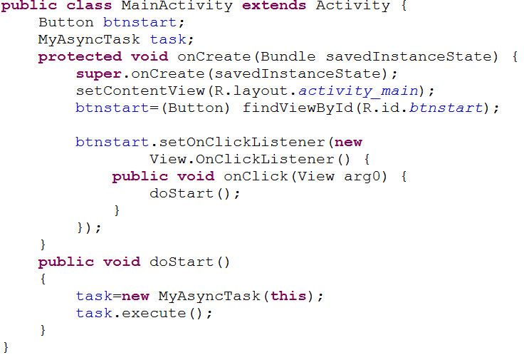
1.3 AsyncTask class

Slide 34
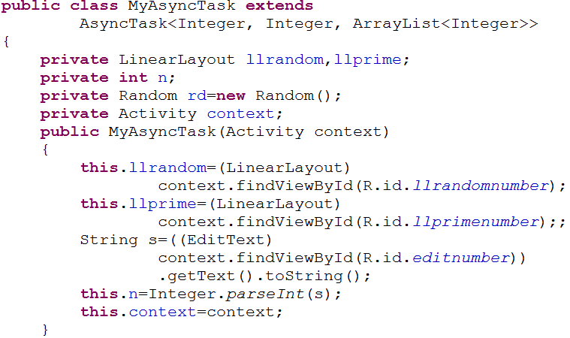
1.3 AsyncTask class

Slide 35
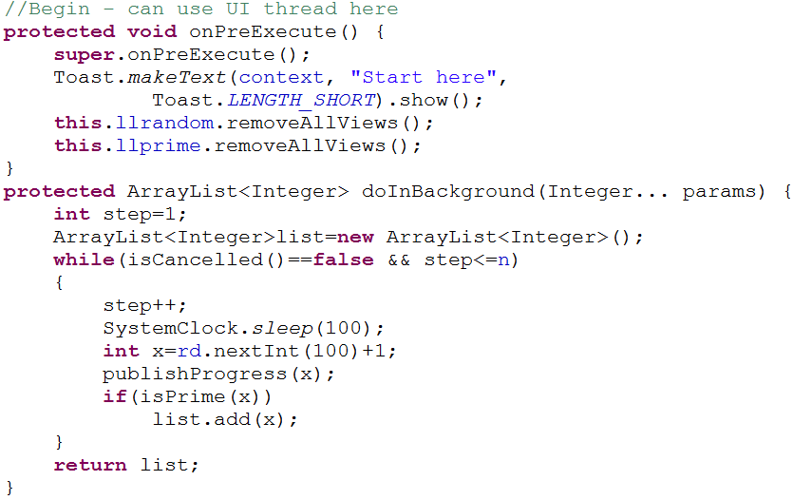
1.3 AsyncTask class

Slide 36
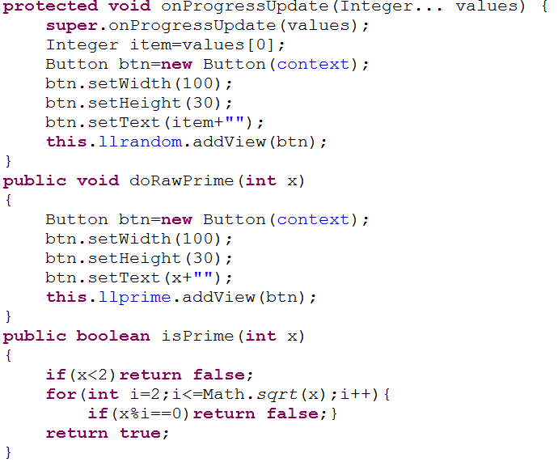
1.3 AsyncTask class

Slide 37
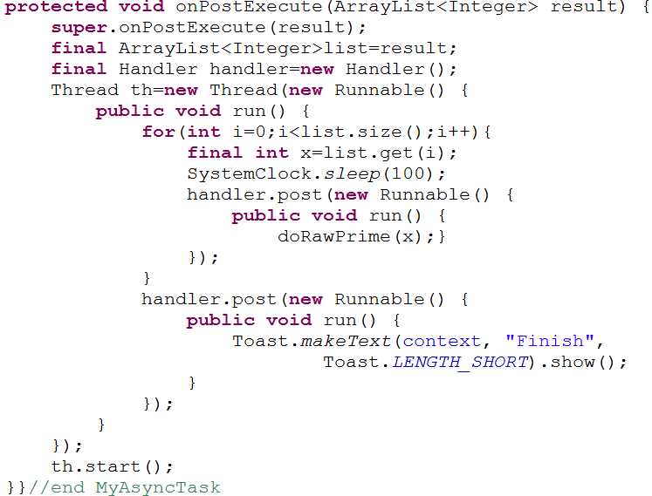
1.3 AsyncTask class

Slide 38
2. Intent filter
INTENTS
An intent is an abstract description of an operation to be performed.
Its most significant use is in the launching of activities.
The primary pieces of information in an intent are:
action & data.
Parts of a Typical Intent
http://developer.android.com/reference/android/content/Intent.html

Slide 39
2. Intent filter
The intent resolution mechanism basically revolves around matching an Intent against all of the <intent‐filter> descriptions in the installed application packages.”

Slide 40
2. Intent filter
intent filters that specify the
android.intent.action.MAIN action and
android.intent.category.LAUNCHER Category:
It then displays the icons and labels of those activities in the launcher

Slide 41
2. Intent filter
Intent Resolution: example
Assume the user has installed a “Fancy SMS” application to (perhaps) replace the standard “HUMBLE SMS” app originally included in Android.
Upon the arrival of the implicit Intent, Android will (somehow) tell the user:
You have got a new text‐message. I have a FANCY and a HUMBLE SMS application – which one you want me to execute? Make it a default?
Choosing candidates: For an activity to be eligible for execution it must:
1. Support the specified action
2. Support the indicated MIME type (if supplied)
3. Support all of the categories named in the intent.

Slide 42
2. Intent filter
Common case:
For example, a <data> element like the following tells Android that the component can get video data from the network and display it:
<data android:scheme="http" android:type="video/*" />
• Usage examle
Consider what the browser application does when the user follows a link on a web page.
It first tries to display the data (as it could if the link was to an HTML page). If it can't display the data, it puts together an implicit intent with the scheme and data type and tries to start an activity that can do the job. If there are no takers, it asks the download manager to download the data.

Slide 43
2. Intent filter
Common case:
The example below tells Android that the component can get image data from a content provider and display it:
<data android:mimeType="image/*" />
Since most available data is dispensed by content providers, filters that specify a data type but not a URI are perhaps the most common.

Slide 44
2. Intent filter
Example:
Share picture
img.setImageURI((Uri) getIntent().getExtras().get(Intent.EXTRA_STREAM));

Slide 45
3. Broadcast Receiver
Broadcast Receiver Lifecycle
A Broadcast Receiver is an application class that listens for Intents that are broadcast, rather than being sent to a single target application/activity.
The system delivers a broadcast Intent to all interested broadcast receivers, which handle the Intent sequentially.

Slide 46
3. Broadcast Receiver
Broadcast Receiver Lifecycle
A broadcast receiver has a single callback method:
void onReceive(Context curContext, Intent broadcastMsg)
1.When a broadcast message arrives for the receiver, Android calls its onReceive()method and passes it the Intent object containing the message.
2.The broadcast receiver is considered to be active only while it is executing this method.
3.When onReceive() returns, it is inactive.

Slide 47
3. Broadcast Receiver
Registering a Broadcast Receiver
1. You can either dynamically register an instance of this class with Context.registerReceiver()
2. or statically publish an implementation through the <receiver> tag in your AndroidManifest.xml.
Manifest
the application defines a BroadcastReceiver as an independent class, it must include a <receiver> clause identifying the component. In addition an <intent-filter> entry is needed to declare the actual filter the service and the receiver use.

Slide 48
3. Broadcast Receiver
Manifest

Slide 49
3. Broadcast Receiver
Types of Broadcasts
There are two major classes of broadcasts that can be received:
1.Normal broadcasts(sent with Context.sendBroadcast) are completely asynchronous. All receivers of the broadcast are run in an undefined order, often at the same time.
2.Ordered broadcasts(sent with Context.sendOrderedBroadcast) are delivered to one receiver at a time.
The order receivers run in can be controlled with the android:priority attribute of the matching intent-filter;
abortBroadcast()

Slide 50
3. Broadcast Receiver
Standard Broadcast given by the platform
 AIRPLANE_MODE
 ACTION_TIME_TICK
 ACTION_TIME_CHANGED
 ACTION_TIMEZONE_CHANGED
 ACTION_BOOT_COMPLETED
 ACTION_PACKAGE_ADDED
 ACTION_PACKAGE_CHANGED
 ACTION_PACKAGE_REMOVED
 ACTION_PACKAGE_RESTARTED
 ACTION_PACKAGE_DATA_CLEARED
 ACTION_UID_REMOVED
 ACTION_BATTERY_CHANGED
 ACTION_POWER_CONNECTED
 ACTION_POWER_DISCONNECTED
 ACTION_SHUTDOWN

Slide 51
3. Broadcast Receiver
Sender
Send broadcast
Action
Receiver
Any activity that intends to respond to broadcasts has to have class extend the android.content.BroadcastReceiver and implement the single method onReceive()
Manifest file
Action

Slide 52
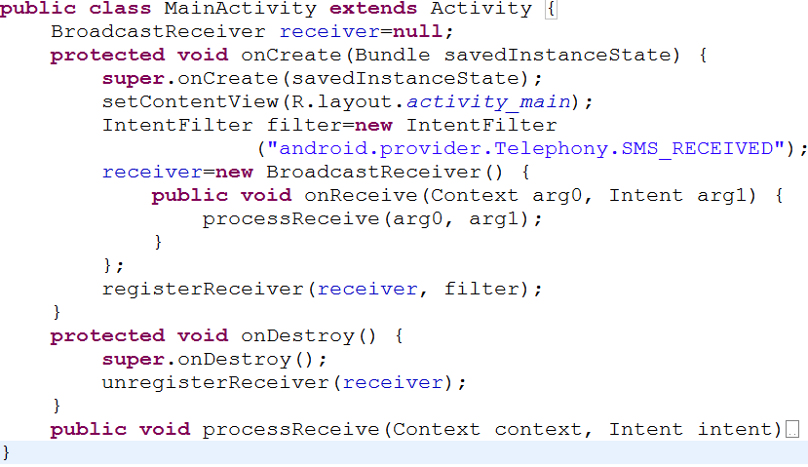
3. Broadcast Receiver
Register BroadCast Receiver by coding

Slide 53
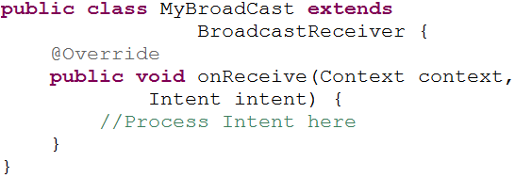
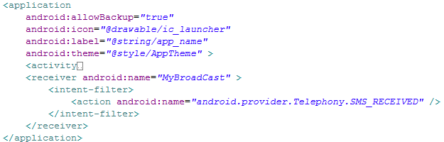
3. Broadcast Receiver
Register BroadCast Receiver by Manifest XML

Slide 54
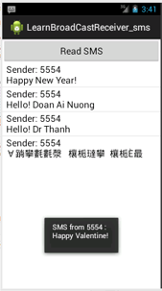
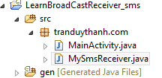
3. Broadcast Receiver
Example read SMS by Broadcast Receiver
Click Read SMS to read all inbox sms
Automatic show information when the phone receives any SMS message (even this application is destroy)

Slide 55
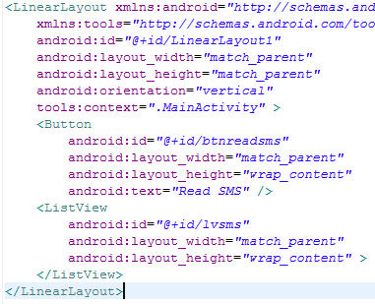
3. Broadcast Receiver
Layout XML

Slide 56
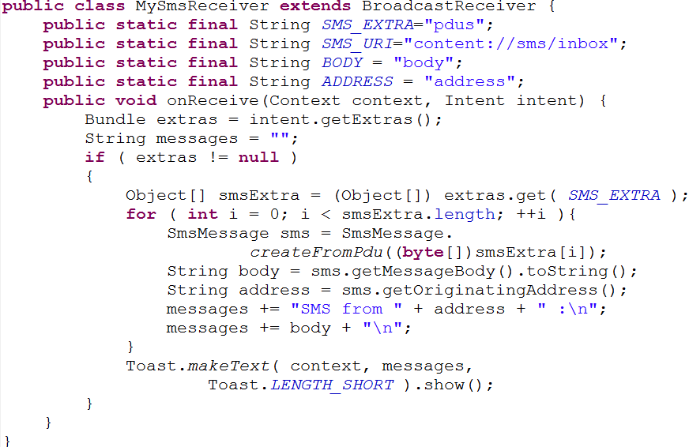
3. Broadcast Receiver
MySmsReceiver class

Slide 57
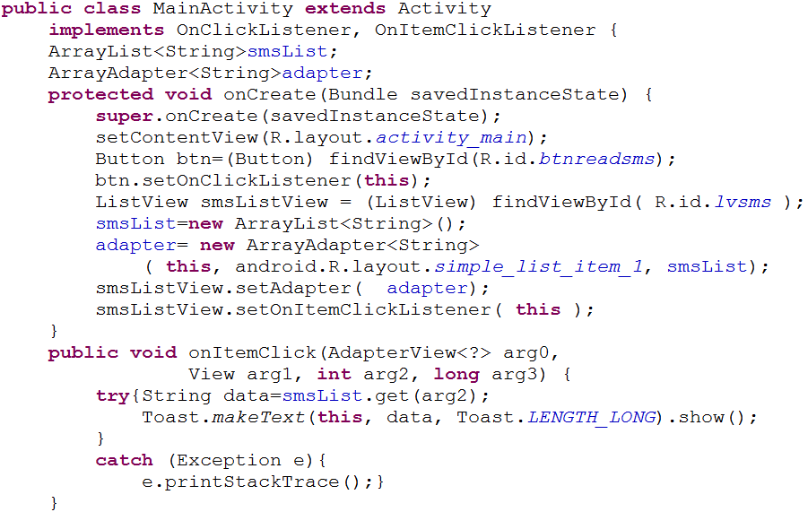
3. Broadcast Receiver
MainActivity class

Slide 58
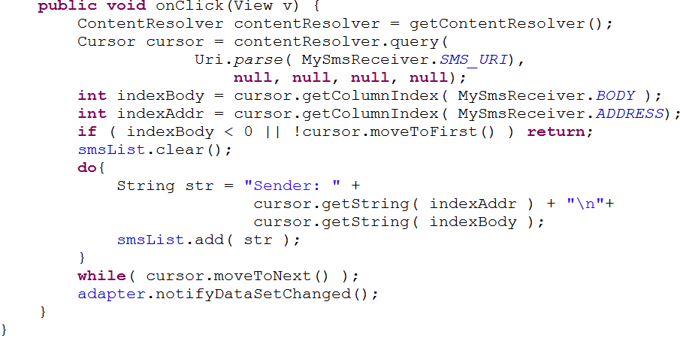
3. Broadcast Receiver
MainActivity class

Slide 59
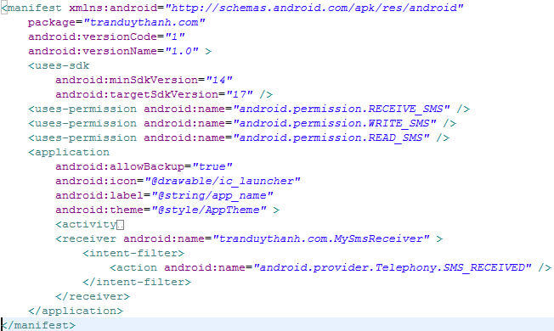
3. Broadcast Receiver
Manifest XML

Slide 60
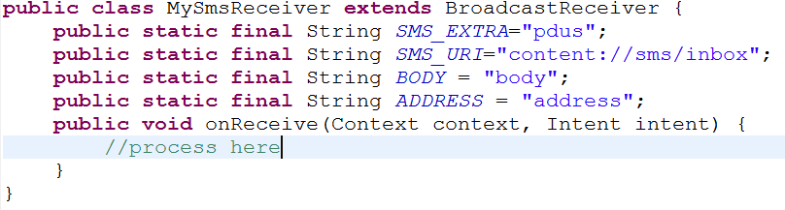
3. Broadcast Receiver
Manifest XML
MySmsReceiver is as a services when register in Manifest XML.
When .apk is installed in the Phone, it becomes a Services. So you don’t need to launch the application but it still receives broadcast when any SMS come in.
Automatic go to onReceive
SMS come in

Slide 61
4. Android Services
1.1 Services
1.2 PendingIntent
1.3 AlarmManager
1.4 NotificationManager

Slide 62
1.1 Services
A Service is an application component that runs in the background, not interacting with the user, for an indefinite period of time.
Run in the main thread of their hosting process. This means that
Each service class must have a corresponding <service> declaration in its package's AndroidManifest.xml.
Services can be started with Context.startService() and Context.bindService().

Slide 63
1.1 Services
singleton
Multiple calls to Context.startService() do not nest (though they do result in multiple corresponding calls to the onStart() method of the Service class)
Only one stopService( )call is needed to stop the service, no matter how many times startService() was called.
A service can be started and allowed to run until someone stops it or it stops itself.
stopped when: Context.stopService() or stopSelf() is called.

Slide 64
1.1 Services
Service Life Cycle
Like activity
has lifecycle methods to monitor changes in its state.
fewer than the activity methods
1.void onCreate()
2.void onStart(Intentintent)
3.void onDestroy()

Slide 65
1.1 Services
Service Life Cycle
The entire lifetime of a service happens between the time onCreate() is called and the time onDestroy() returns.
Like an activity, a service does its initial setup in onCreate(), and releases all remaining resources in onDestroy().
For example, a music playback service could create the thread where the music will be played in onCreate(), and then stop the thread in onDestroy().

Slide 66
1.1 Services
The manifest of applications using Android Services must include:
1.A <service> entry for each service used in the application.
2.If the application defines a BroadcastReceiveras an independent class, it must include a <receiver> clause identifying the component. In addition an <intent-filter> entry is needed to declare the actual filter the service and the receiver use.

Slide 67
1.1 Services

Slide 68

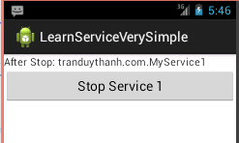
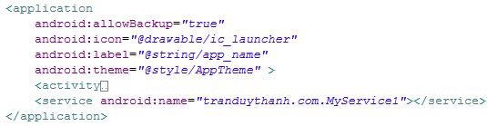
1.1 Services
Example 1. A very Simple Service
The main application starts a service. The service prints lines on the DDMS LogCat until the main activity stops the service. No IPC occurs in the example.

Slide 69
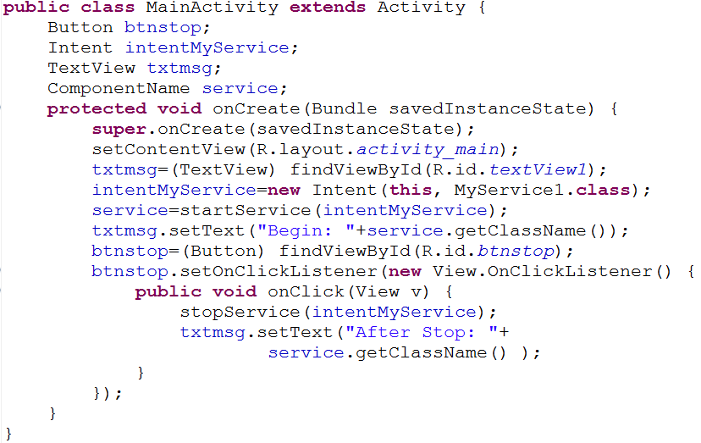
1.1 Services
Example 1. cont

Slide 70
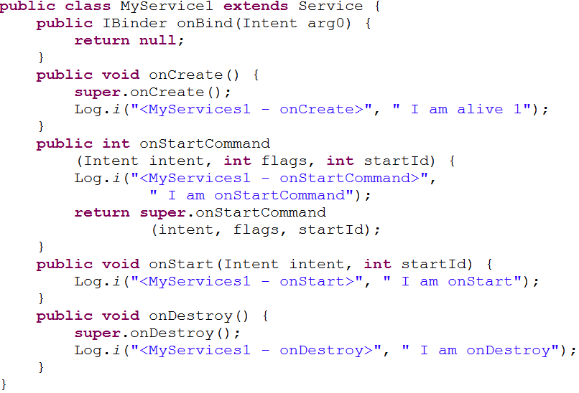
1.1 Services
Example 1. cont

Slide 71
1.1 Services
Communication with service
Broadcast
Binder
Messenger

Slide 72
1.1 Services
Using Broadcast
Assume main activity MyService3Driver wants to interact with a service called MyService3. The main activity is responsible for the following tasks:

Slide 73
1.1 Services
Using Broadcast

Slide 74
1.1 Services
Using Broadcast

Slide 75
1.1 Services
Example 2 - Broadcast
1.The main activity starts the service and registers a receiver.
2.The service is slow, therefore it runs in a parallel thread its time consuming task.
3.When done with a computing cycle, the service adds a message to an intent.
4.The intent is broadcasted using the filter: matos.action.GOSERVICE3.
5.A BroadcastReceiver(defined inside the main Activity) uses the previous filter and catches the message (displays the contents on the main UI ).
6.At some point the main activity stops the service and finishes executing

Slide 76
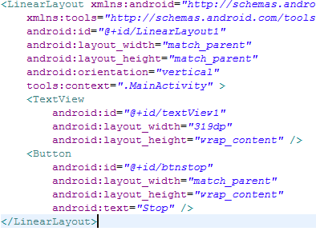
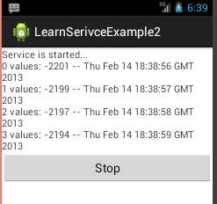
1.1 Services
Example 2 - Broadcast
XML Layout

Slide 77
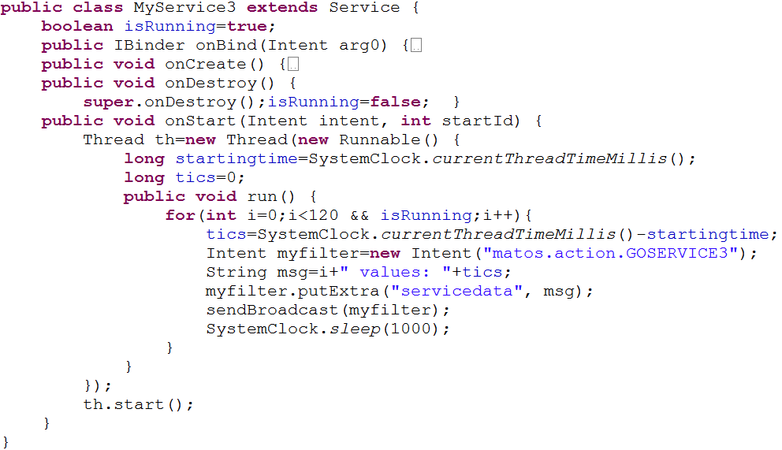

1.1 Services
Example 2 - Broadcast

Slide 78
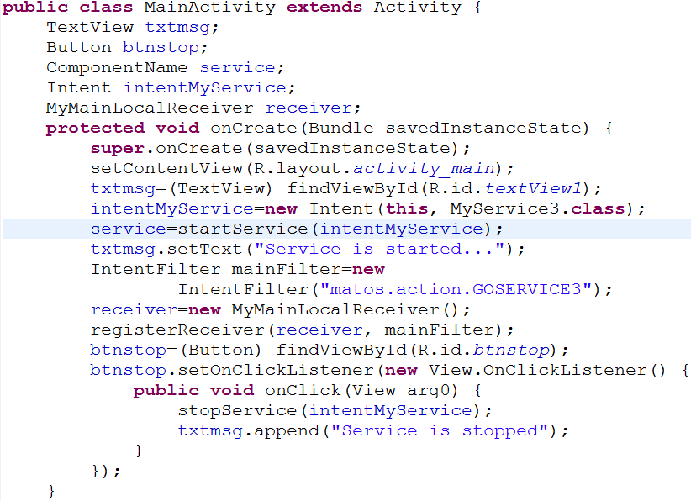
1.1 Services
Example 2 - Broadcast

Slide 79
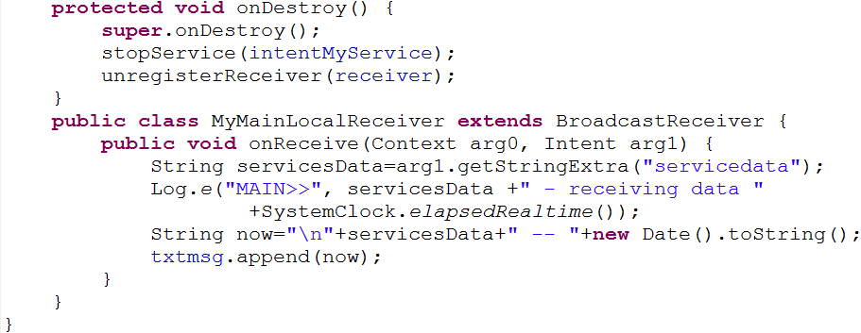
1.1 Services
Example 2 - Broadcast

Slide 80
1.1 Services
Binding service
local binding
sync from activity to service
Activity get service’s instance
Throught ServiceConnection (Activity) + Binder (Service)
Using bindService method
unbindService: for stop service
Take yourself
Click here to get Example

Slide 81
1.1 Services
Using Messager
Extends Handler for activity and service
Take Messenger for activity and service
Activity get Messenger from service in method onServiceConnected
Send message between activity and service from messenger
Messenger.Send(Message)
Process message in handleMessage(Message msg)
Define constant
Take yourself
Click here to get Example

Slide 82
1.2 PendingIntent
A PendingIntent is a token that you give to another application (e.g. Notification Manager, Alarm Manager or other 3rd party applications), which allows this other application to use the permissions of your application to execute a predefined piece of code.
To perform a broadcast via a pending intent so get a PendingIntent via PendingIntent.getBroadcast(). To perform an activity via an pending intent you receive the activity via PendingIntent.getActivity().

Slide 83
1.3 AlarmManager
system services.
AlarmManager am = (AlarmManager) getSystemService(Context.ALARM_SERVICE);
allow you to schedule your application to be run at some point in the future.
When an alarm goes off
PendingIntent will be called.
To set an absolute time for event
if the device is on stand-by, use the RTC_WAKEUP type.
one shot or repeating
alarmManager.set(AlarmManager.RTC_WAKEUP,
calendar.getTimeInMillis(),pendingIntent);
alarmManager.setRepeating(type, triggerAtTime, interval, pendingIntent))

Slide 84
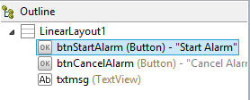
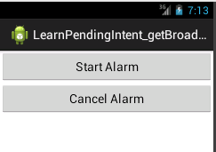
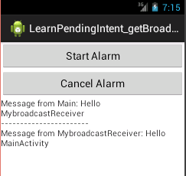
1.3 AlarmManager
Example 1: PendingIntent.getBroadcast
Old MainActivity
MyBroadcastReceiver
Open new instance of MainActivity

Slide 85
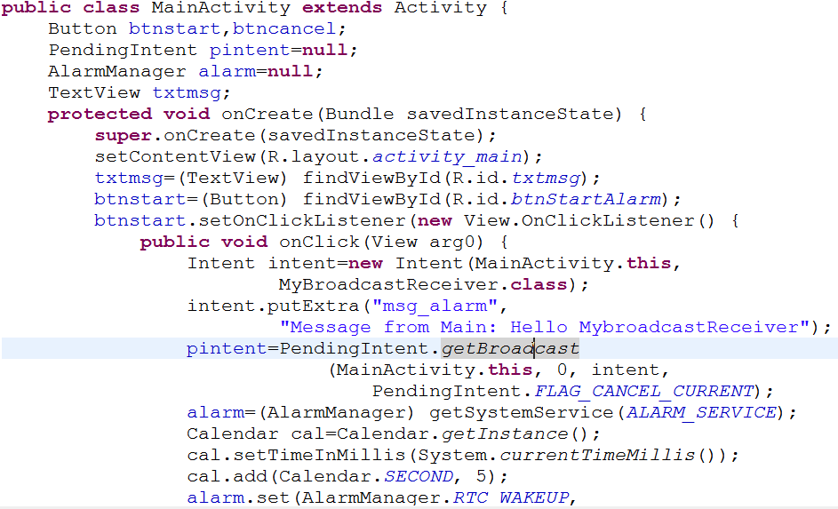
1.3 AlarmManager
Example 1: cont

Slide 86
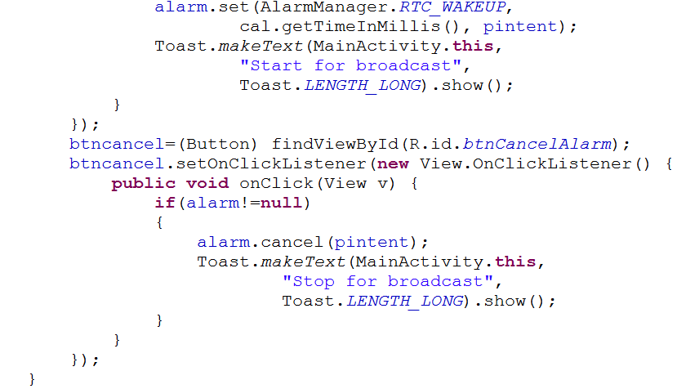
1.3 AlarmManager
Example 1: cont

Slide 87
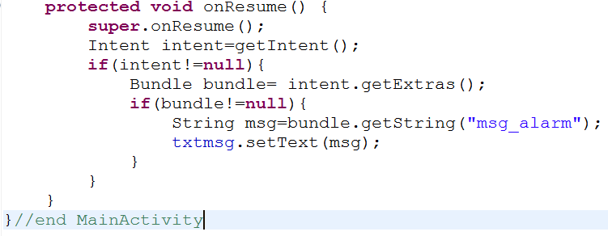
1.3 AlarmManager
Example 1: cont

Slide 88
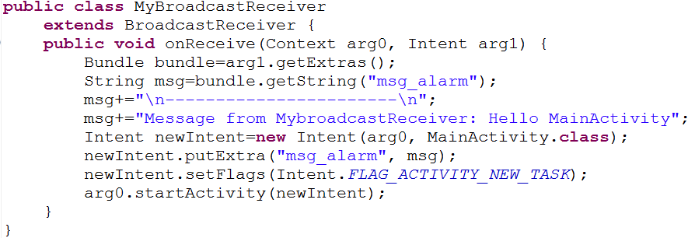
1.3 AlarmManager
Example 1: cont

Slide 89
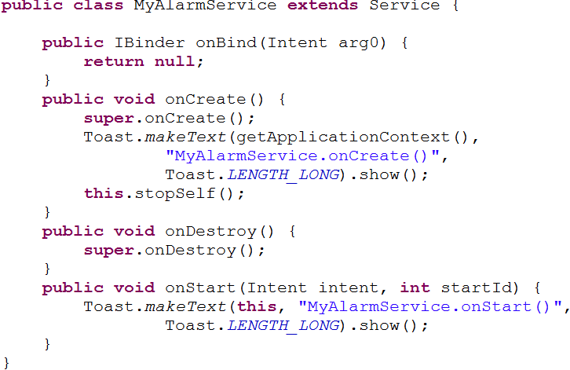
1.3 AlarmManager
Example 2: PendingIntent.getService

Slide 90
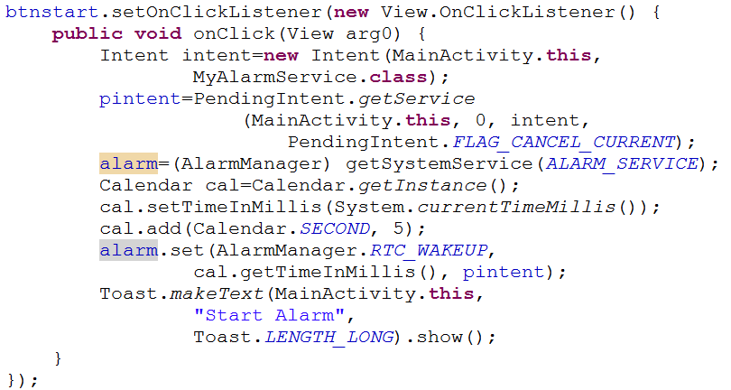
1.3 AlarmManager
Example 2: PendingIntent.getService

Slide 91
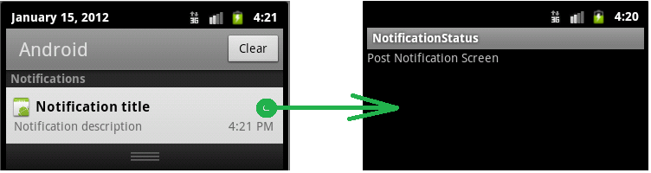
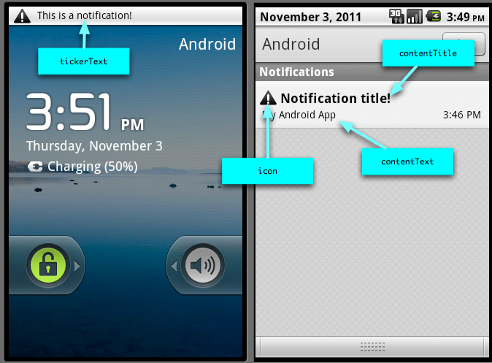
1.4 NotificationManager

Slide 92
1.4 NotificationManager
System service
alerting a user about an event
Notification on Android can be done in any of the following ways:
Status Bar Notification
Vibrate
Flash lights
Play a sound
We need:
Notification
defines the properties of the status bar notification like the icon to display, the test to display when the notification first appears on the status bar and the time to display
NotificationManager
android system service that executes and manages all notifications.

Slide 93
1.4 NotificationManager
NotificationManager
NotificationManager nm = (NotificationManager) context.getSystemService(Context.NOTIFICATION_SERVICE)
Create a new Notification object with an icon, a title and the time (probably System.currentTimeMillis()) Set some flags
notification.defaults |= Notification.DEFAULT_SOUND; notification.defaults |= Notification.DEFAULT_VIBRATE;
Use setLatestEventInfo method to set another PendingIntent into the notification.
The Activity in this intent will be called when the user clicks the notification.

Slide 94
1.4 NotificationManager
Step 1: Procure a handle to the NotificationManager: private NotificationManager mNotificationManager; mNotificationManager = (NotificationManager)getSystemService(NOTIFICATION_SERVICE);
Step 2: Create a notification object along with properties to display on the status bar final Notification notifyDetails = new Notification(R.drawable.android,"New Alert, Click Me!",System.currentTimeMillis());

Slide 95
1.4 NotificationManager
Step 3: Add the details that need to get displayed when the user clicks on the notification.
Context context = getApplicationContext();
CharSequence contentTitle = "Notification Details...";
CharSequence contentText = "Browse Android Official Site by clicking me";
Intent notifyIntent = new Intent(Intent.ACTION_VIEW,
Uri.parse("http://www.android.com"));
PendingIntent pintent =
PendingIntent.getActivity(SimpleNotification.this, 0, notifyIntent,
Intent.FLAG_ACTIVITY_NEW_TASK);
notifyDetails.setLatestEventInfo
(context, contentTitle, contentText, pintent);

Slide 96
1.4 NotificationManager
Step 4: Now the stage is set. Notify.
mNotificationManager.notify
(SIMPLE_NOTFICATION_ID, notifyDetails);
mNotificationManager.cancel
(SIMPLE_NOTFICATION_ID);

Slide 97
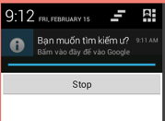



1.4 NotificationManager
Example : Show notification

Slide 98

1.4 NotificationManager
Example : cont

Slide 99

1.4 NotificationManager
Example : cont

Slide 100
5. Webservice .Net
5.1 Introduction Webservice
5.2 How to create .Net Webservice
5.3 How to config IIS
5.4 KSOAP API
5.5 Android to .Net Webservice

Slide 101
5.1 Introduction Webservice
Support machine-to-machine collaboration.
They can be described, published, located, and invoked over a data network.
Web services are used to implement the notion of a service-oriented architecture (SOA).
SOA applications are independent of specific programming languages or operating systems.
Web services rely on existing transport technologies, such as HTTP, and XML, for invoking the implementation.

Slide 102
5.1 Introduction Webservice
The interface describing the format of services can be done using the Web Services Description Language (WSDL). According to W3C there are two major types of web services
REST-compliant which use XML to represent its Web resources, and offers a "stateless" set of operations; and
Arbitrary solutions, in which the service may expose a heterogeneous set of operations.

Slide 103
5.1 Introduction Webservice
Two widely used architectures supporting Web services are
Representational State Transfer (REST) Closely tie to the HTTP protocol by associating its operation to the common GET, POST, PUT, DELETE for HTTP.
Remote Procedure Call (RPC). Web services are directly implemented as language-specific functions or method calls. In this category we find
1.Object Management Group's (OMG) Common Object Request Broker Architecture (CORBA),
2.Microsoft's Distributed Component Object Model (DCOM) and
3.Sun Microsystems's Java/Remote Method Invocation (RMI).

Slide 104
5.1 Introduction Webservice
IIS webserver (RPC discrete function oriented approach)

Slide 105
5.1 Introduction Webservice
Services are passive server-side pieces of code waiting for incoming messages to do some work. Clients initiate the interaction by sending a message to server-services requesting action.
Services expose one or more endpoints where messages can be sent. Each endpoint consists of
address (where to send messages)
binding (how to send messages )
contract (what messages contain)
Clients can use WSDL to know this information before accessing a service.

Slide 106
5.1 Introduction Webservice
Windows Communication Foundation (WCF) uses the information found in the service contract to perform dispatching and serialization.
Dispatching is the process of deciding which method to call for an incoming SOAP message.
Serialization is the process of mapping between the data found in a SOAP message and the corresponding .NET objects used in the method

Slide 107

5.2 How to create .Net Webservice
1. Create a database in SQL Server with name dbProductManager
The Table Structer as below:
2. Computer Server will support some services:
Get number of catalog
Get list Catalog
Get list product by Catalog id
3. Android application will connect to the computer Server and get information via service method (The Android Mobile will connect to Laptop by Wireless – must Win 7, Win 8)

Slide 108

5.2 How to create .Net Webservice
1- Create Webservice project with name MyProductService as below:

Slide 109



5.2 How to create .Net Webservice
2- Create Webservice class with name ProductWebService:
- Right click on Project/ Add/ Web Service

Slide 110


5.2 How to create .Net Webservice
3- Write coding :
For Product table
For Catalog table
Must use Serializable

Slide 111

5.2 How to create .Net Webservice
3- Write coding :
For connection

Slide 112

5.2 How to create .Net Webservice
3- Write coding :
For connection

Slide 113


END

